Slide 1
Capstone Project 4 Unsupervised Learning
Customer Segmentation
By
Gottipati Gopichand and Thurab

Slide 2
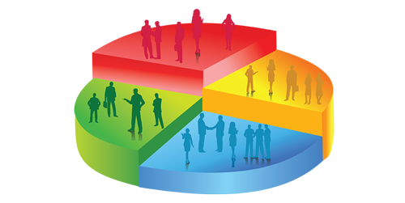
Let’s Find Interesting Insights From Customer Segmentation
Defining problem statement
Cleaning the data
Deep dive into EDA
Grouping important data and visualizing
RFM Analysis
Clustering Analysis
Conclusion

Slide 3
Why Customer segmentation?
Customer segmentation is popular because it helps you market and sell more effectively. This is because you can develop a better understanding of your customers’ needs and desires.
The business impact of doing this is even more important, and effective customer segmentation will help you to increase customer lifetime value. This means they will stay longer, and spend more.
By better understanding the customer, and therefore being able to target them more effectively, you can drive greater loyalty. Instead of customers visiting Kiehl’s two times a year to get skincare products (with a big basket size), segmentation can give you insights that will help you get customers returning 5x a year with smaller basket sizes. Although each basket is smaller, you’ve increased customer loyalty because they are interacting with the business more frequently.
Little and often is disproportionately more effective than a one-off. It is a more predictive indicator of behavior too, which will help inform business decisions. Not only that it will improve loyalty but it will increase the value of the customer, meaning the lifetime value of the customer will increase.

Slide 4
Problem Statement:-
In this project, your task is to identify major customer segments on a transnational data set which contains all the transactions occurring between 01/12/2010 and 09/12/2011 for a UK-based and registered non-store online retail. The company mainly sells unique all occasion gifts Many customers of the company are wholesalers.
This dataset consists of 541909 different types of customers data with 8 different columns present in it by using these dataset we will answer the following questions like:
1)How many types of customers present?
2)Which type of customers need to be concentrated ?
3)How to decrease the loss and increase the profit?

Slide 5
Data Description
Attribute Information:
Invoice No: Invoice number. Nominal, a 6-digit integral number uniquely assigned to each transaction. If this code starts with letter 'c', it indicates a cancellation.
Stock Code: Product (item) code. Nominal, a 5-digit integral number uniquely assigned to each distinct product.
Description: Product (item) name. Nominal.
Quantity: The quantities of each product (item) per transaction. Numeric.
Invoice Date: Invice Date and time. Numeric, the day and time when each transaction was generated.
Unit Price: Unit price. Numeric, Product price per unit in sterling.
Customer ID: Customer number. Nominal, a 5-digit integral number uniquely assigned to each customer.
Country: Country name. Nominal, the name of the country where each customer resides.

Slide 6
Steps for deep dive-in EDA
Data processing- Initially loading the data and analyzing and observing the values, usability checking.
Data Cleaning – Cleaning the data and organizing, removing the null and NaN values and making the dataset more usable.
Grouping Data – Data is to be grouped in order to sort and categorize the set, which helps in further understanding.
Attributes- Understanding the attributes of the columns and treating them accordingly for a easier visualization.
Visualize – Visualizing the dataset to get the maximum and minimum values.

Slide 7
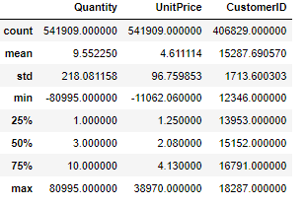
Step1:
From the above dataset we can observe that there are negative values present in our dataset for preventing noise present in dataset. We would remove them permanently.
There are more than 25% null values present in customer id which means we can assume that fraud type of transactions happened in our dataset so for eradicating the noise in our dataset we would remove them.

Slide 8
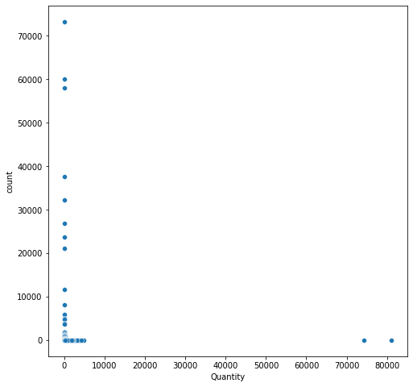
Step2:
There are more number of outliers present in our quantity column. More number of outliers are present when the value of quantity is above 10000 . we would remove the columns where my quantity column is having the value above 10000.

Slide 9
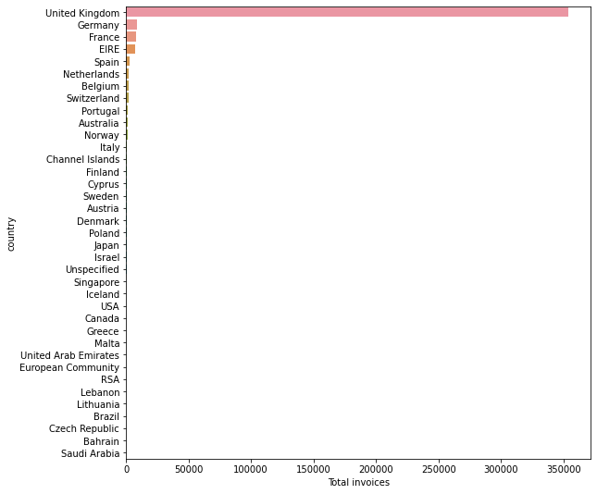
Step3:
From the above obtained visualization we can observe that there are more number of customers
From United kingdom compared to all other countries where as Germany is the second popular
country.

Slide 10
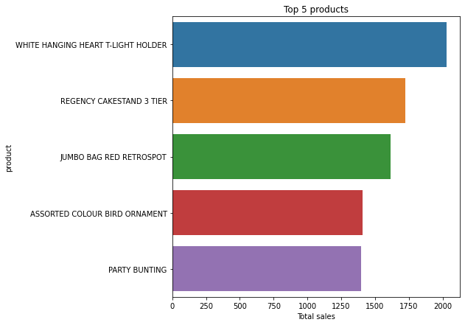
Step4:
For observing the top products we have visualized the top products from there we can understand
Easily that white hanging heart t-light holder is most purchased product by the customers and
Regency cakes 3tier is the second most purchased product.

Slide 11
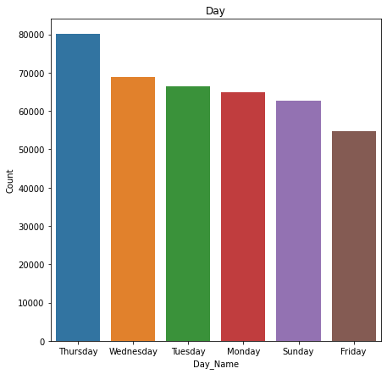
Step5:
We can observe that there are more number of customers purchasing the products on Thursday
and Wednesday is the second most popular purchased day

Slide 12
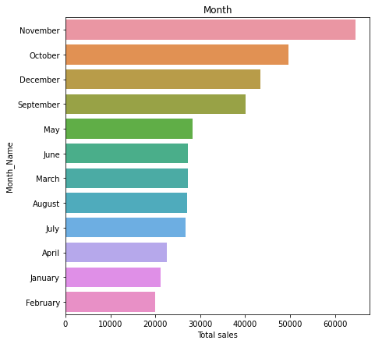
Step6:
From the above obtained plot based on month we can observe that more number of sales are happening on November month means. we can also assume that more sales are happening because every customer is purchasing the required products for the festival before only to make arrangements.

Slide 13
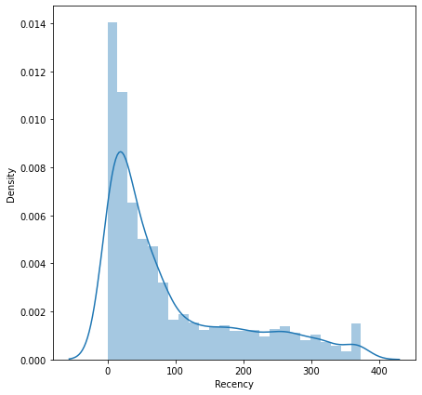
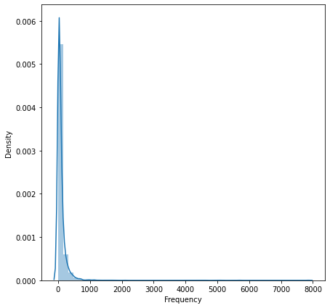
Step7:
Recency(Most recent purchase by customer.)- Calculate the number of days between present date
and date of last purchase each customer.
Frequency(How many times the customer purchased.)- Calculate the number of orders for each
customer.

Slide 14
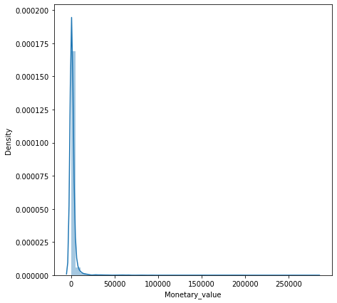
Step8:
Monetary(How much revenue generated through the customer.)- Calculate sum of purchase
price for each customer
By the RFM plots we can observe that there is more stripe present in them. For making them
and understanding them in easy manner we would standardize the graphs so that the plots will
Be clear and we can get clear idea on the values.

Slide 15
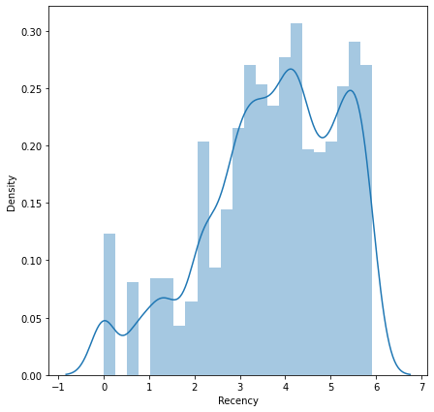
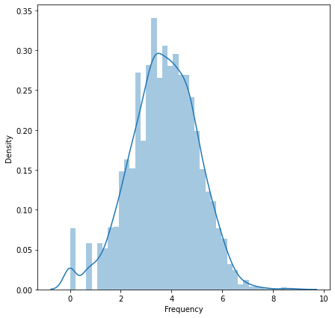
Step9:
From the above obtained plots we can observe that the plots are standardized so that the
values have been reduced and the plots are beautifully standardized by these we can get
clear idea on the values.

Slide 16
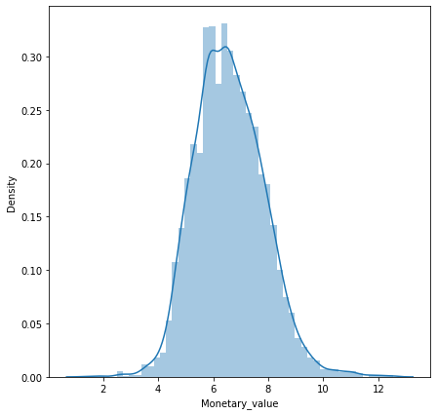
Step10:
The above plotted graph we can easily observe that the values has been reduced and plotted
Clearly.

Slide 17
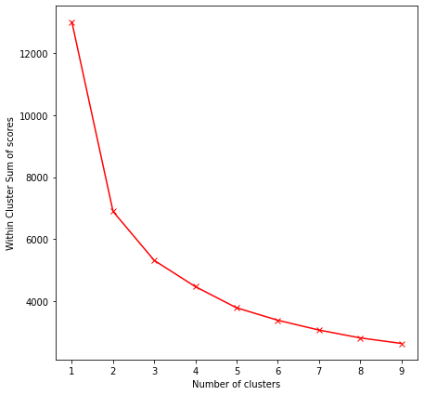
Step11:
From the above plotted elbow method graph we can get idea on number clusters. From the graph we can observe that 4 clusters would be perfect.

Slide 18
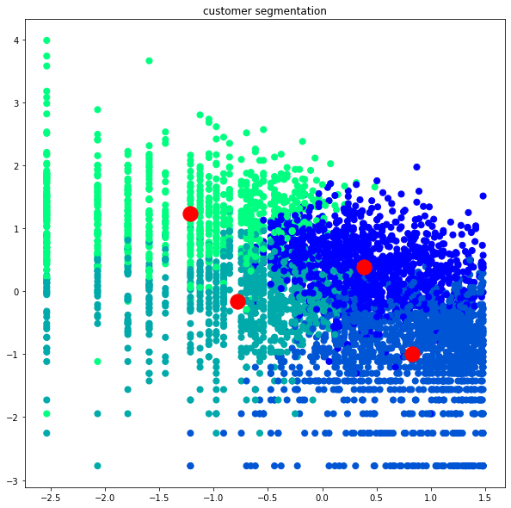
Step12:
The above clustering we can get clear idea on where the customers fall based on the data about
the customers.

Slide 19
Summary of the project:
We would summarize the project with following points: 1.From the given data we can observe that there are more number of null's present in data which means there are almost 25% fraud purchases happened from the data. 2.Based on country we can observe that there are more number of customers from UK it gives us clear idea that data is more concentrated on UK. 3.Suggested Market Strategies for the customer metrics Best customers: Introduce new products to them and create a strong bond
Aggressive Spenders: introduce costly products to them
Almost Lost customers: introduce discounts or price incentives to them
Lost customers: don't spend much about them. 4.The four different types of customers are clustered based on there purchases. so that companies can easily identify where the customer is falling on by that they would make necessary business plans to improve the customers.
​

